Slide 1
Software Engineering
Paulo Borba
Informatics Center
Federal University of Pernambuco
pauloborba.cin.ufpe.br

Slide 2
To do before class
Watch videos
Read chapter 7 and basic concepts of chapter 6 in the textbook
Send questions and opinions through slack

Slide 3
Testing 1: implementation, maintenance and execution
Notes:
as atividades de teste tem como principal objetivo…

Slide 4
Software Engineering
Paulo Borba
Informatics Center
Federal University of Pernambuco
pauloborba.cin.ufpe.br

Slide 5
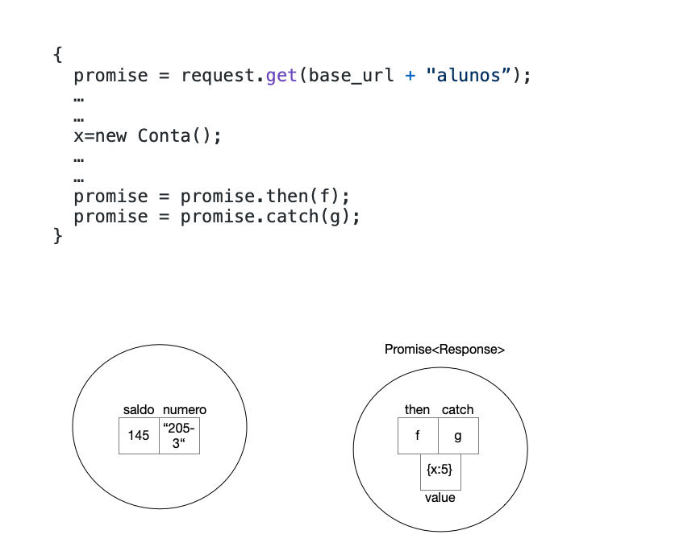

Slide 6
What is software testing?

Slide 7

Main goal is…
quality “assurance”, in theory
evidence that system behaves as expected in specific situations, in practice
evidence is as strong as the test suite
supports not only bug detection, but also bug fixing, and refactoring
Notes:
creating and executing tests increase costs, but detecting and helping to locate bugs decrease costs and avoid disasters, supporting more refactoring also decrease costs
se comporta como esperado, se refere aos requisitos, que podem cobrir diversos aspectos…

Slide 8
Behaves as expected…
functionalities (correctness)
robustness
performance and scalability
presentation and GUI (usability)
security
…
Notes:
vamos então ver como esse processo de coleta de evidencia de que o sistema se comporta como o esperado pode ser feito…

Slide 9
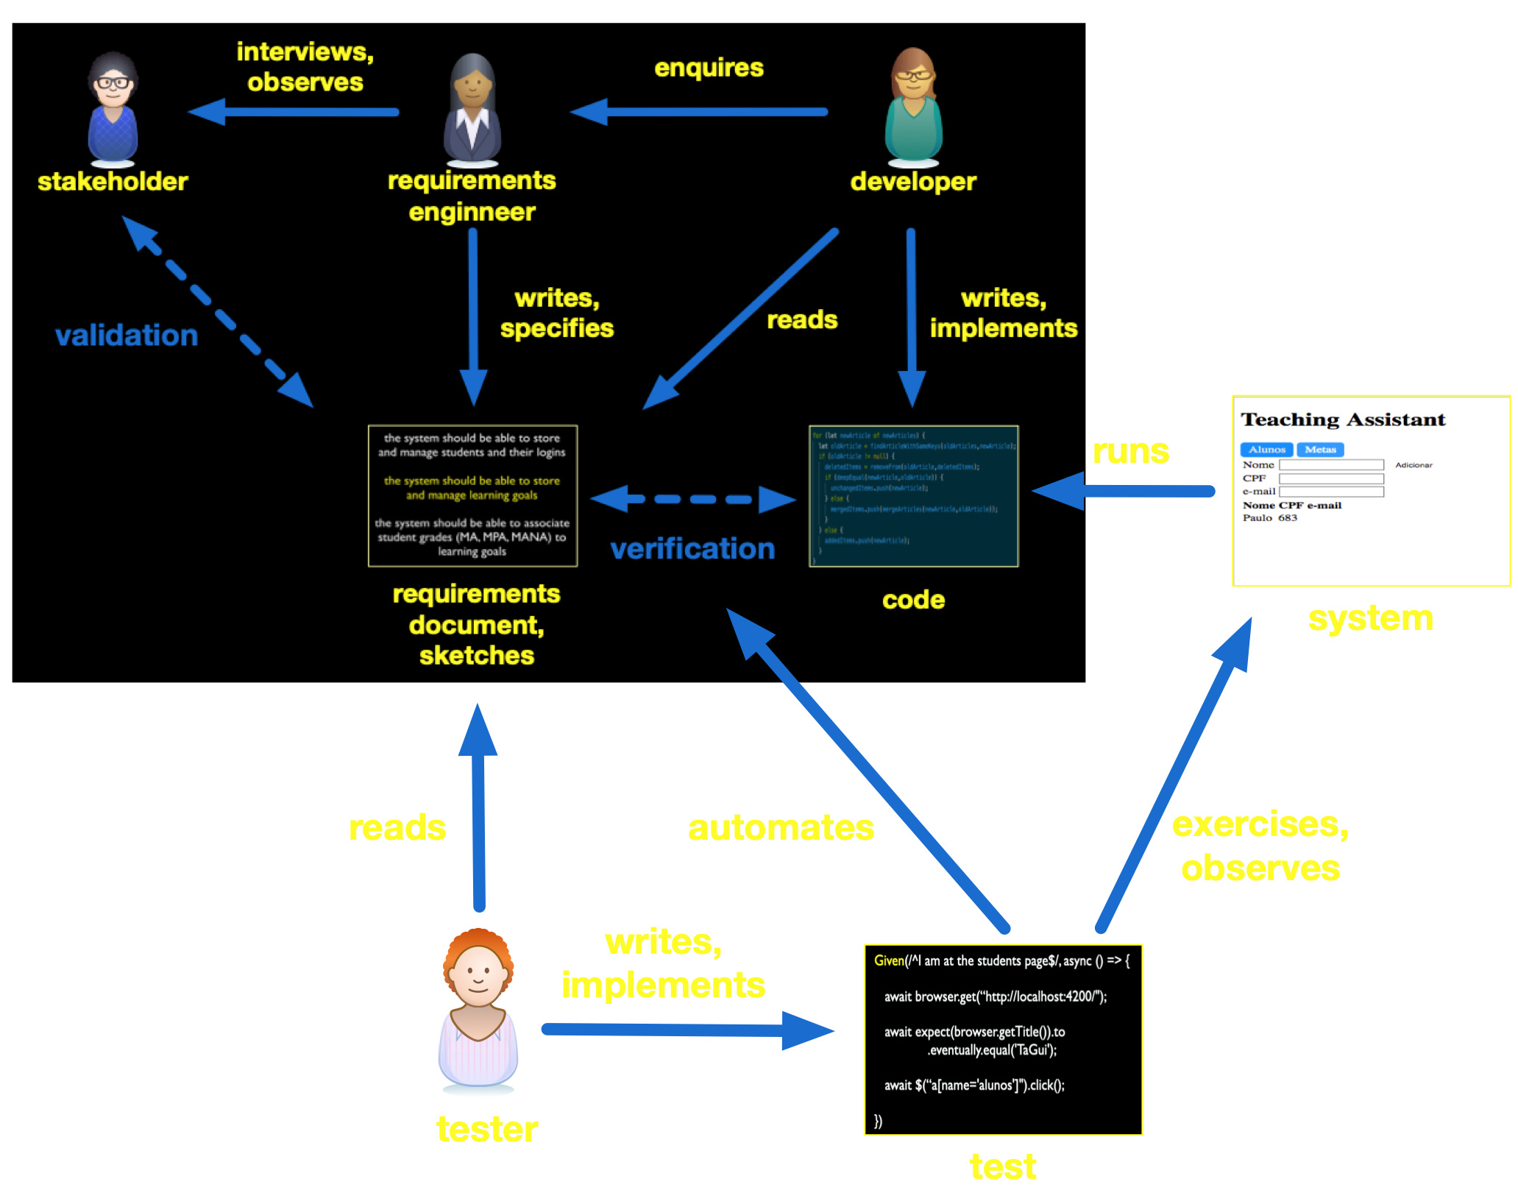
Notes:
vamos ilustrar isso agora com um tipo de teste especifico…

Slide 10
Software Engineering
Paulo Borba
Informatics Center
Federal University of Pernambuco
pauloborba.cin.ufpe.br

Slide 11
What are acceptance tests?

Slide 12
Acceptance tests
Test the system as a whole
Stakeholders accept system release if such tests pass
Notes:
sistema especificado pelos requisitos pode ser visto como…

Slide 13
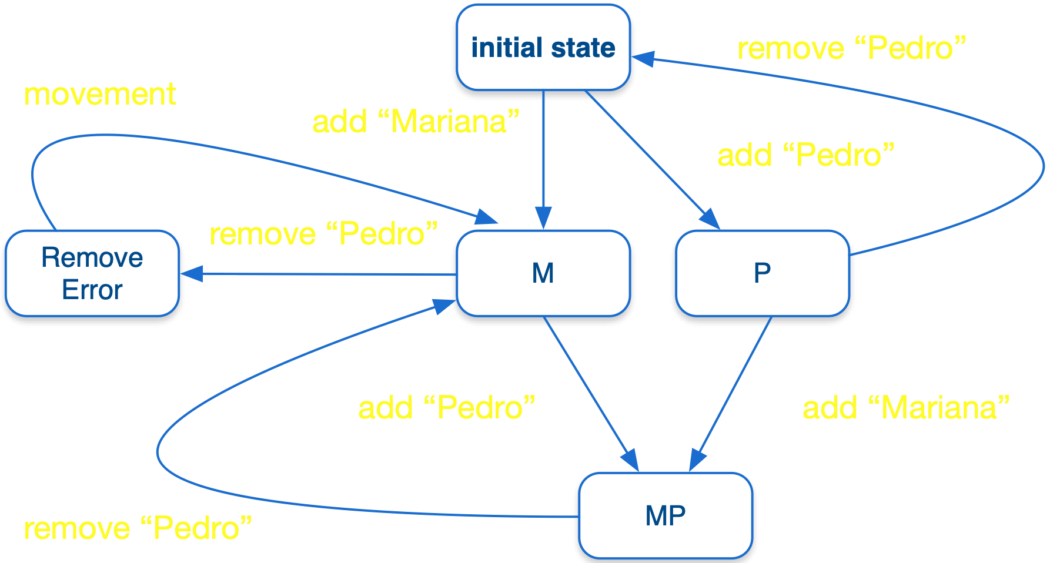
System, class, module, etc. as a state machine
Notes:
e um teste é…

Slide 14
Test as path (often of size one) in the corresponding graph
Notes:
para testes de aceitacao, fazemos uma conexão direta…

Slide 15
Directly connecting requirements (scenarios) and tests
Notes:
partes da maquina de estado foram especificadas por cenários, que são os testes

Slide 16
GUI based test scenario
Scenario: adding new grade
Given I am at the "Grades" page
And I see a student "Maria Silva" with no grade for
learning goal "Write quality tests"
When I add grade "MA" for "Maria Silva" goal
"Write quality tests"
Then I’m still at the "Grades" page
And I can see student "Maria Silva" has
grade "MA" for learning goal
"Write quality tests"
Notes:
formado por partes com propósitos específicos

Slide 17
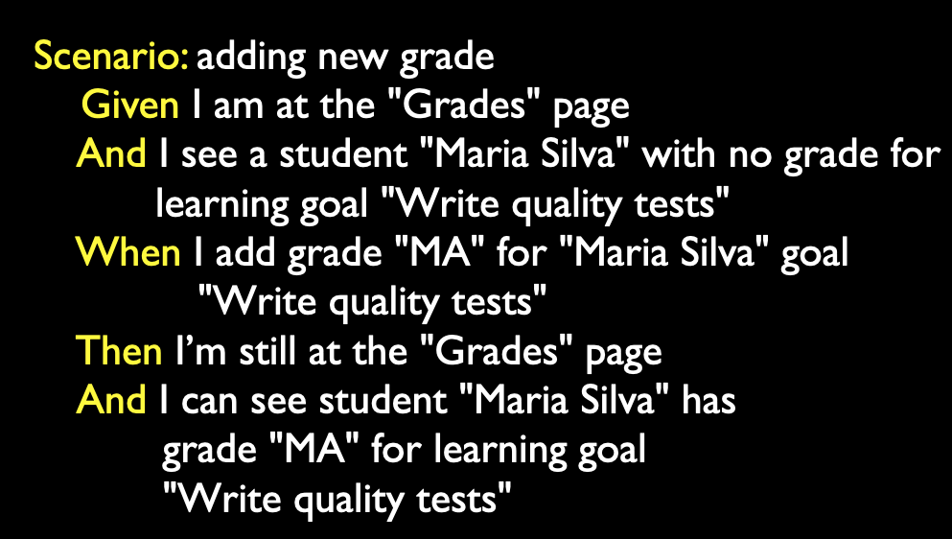
Test structure
setup,
input
test actions
expected results
Notes:
normalmente agrupados em features…

Slide 18
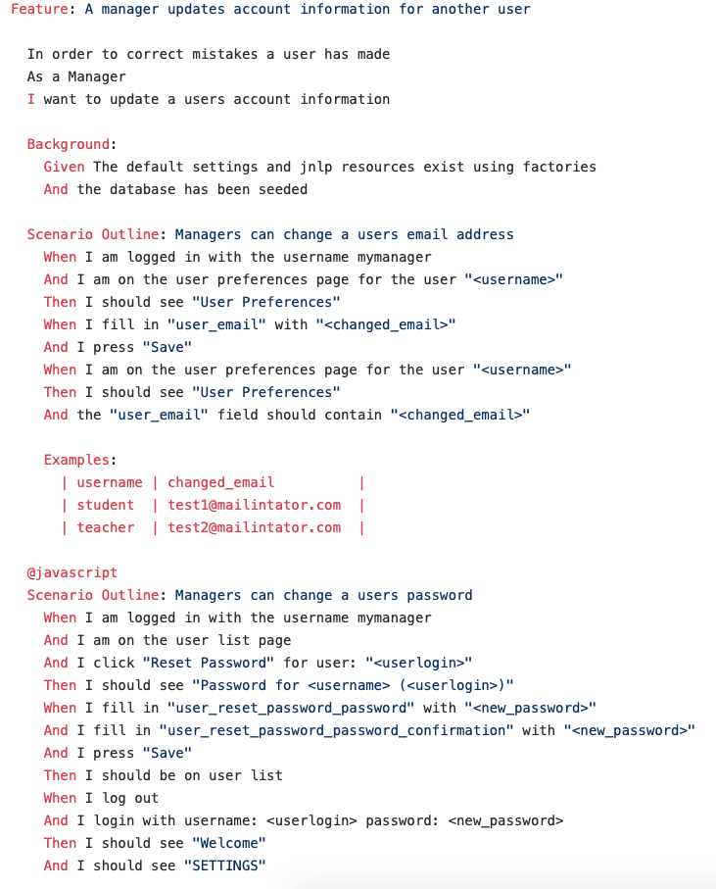


One test suite
Two test scenarios
Three tests, or test cases
https://github.com/concord-consortium/rigse/blob/master/features/manager_updates_account_information.feature
Notes:
nesse tipo especifico de teste de aceitação…

Slide 19
Software Engineering
Paulo Borba
Informatics Center
Federal University of Pernambuco
pauloborba.cin.ufpe.br

Slide 20
What are GUI acceptance tests?

Slide 21
Exercising the system through its GUI
Notes:
we could do that manually, or we could write a program that does that!

Slide 22
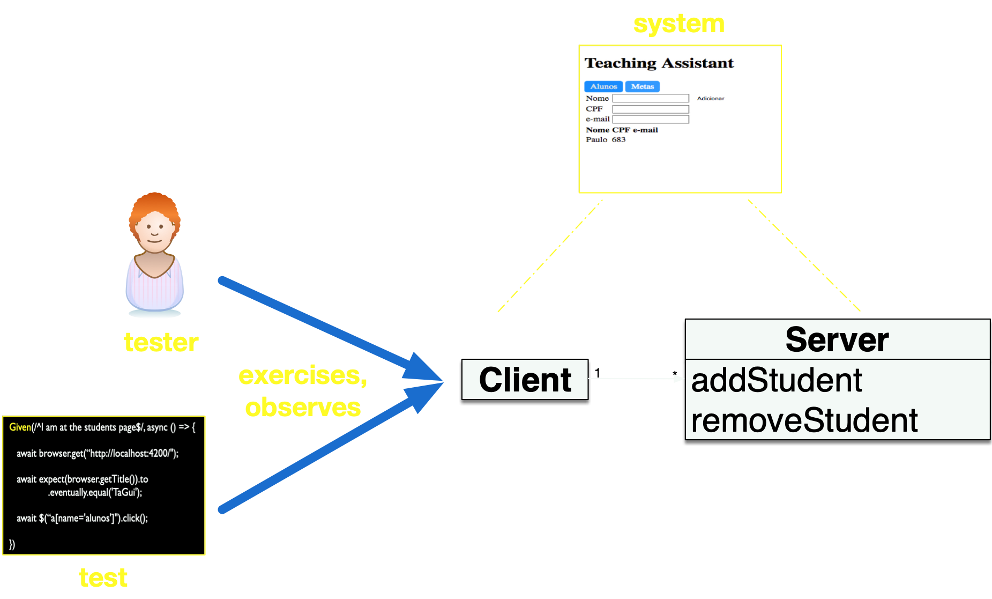
Notes:
as vantagens de automatizar…

Slide 23
Automated vs manual tests
expensive to create
inexpensive to execute
enables regression testing, continuous testing
some might be hard to create (complicated oracle)
expensive to execute
boring, failures might be missed
avoids oracle problem

Slide 24
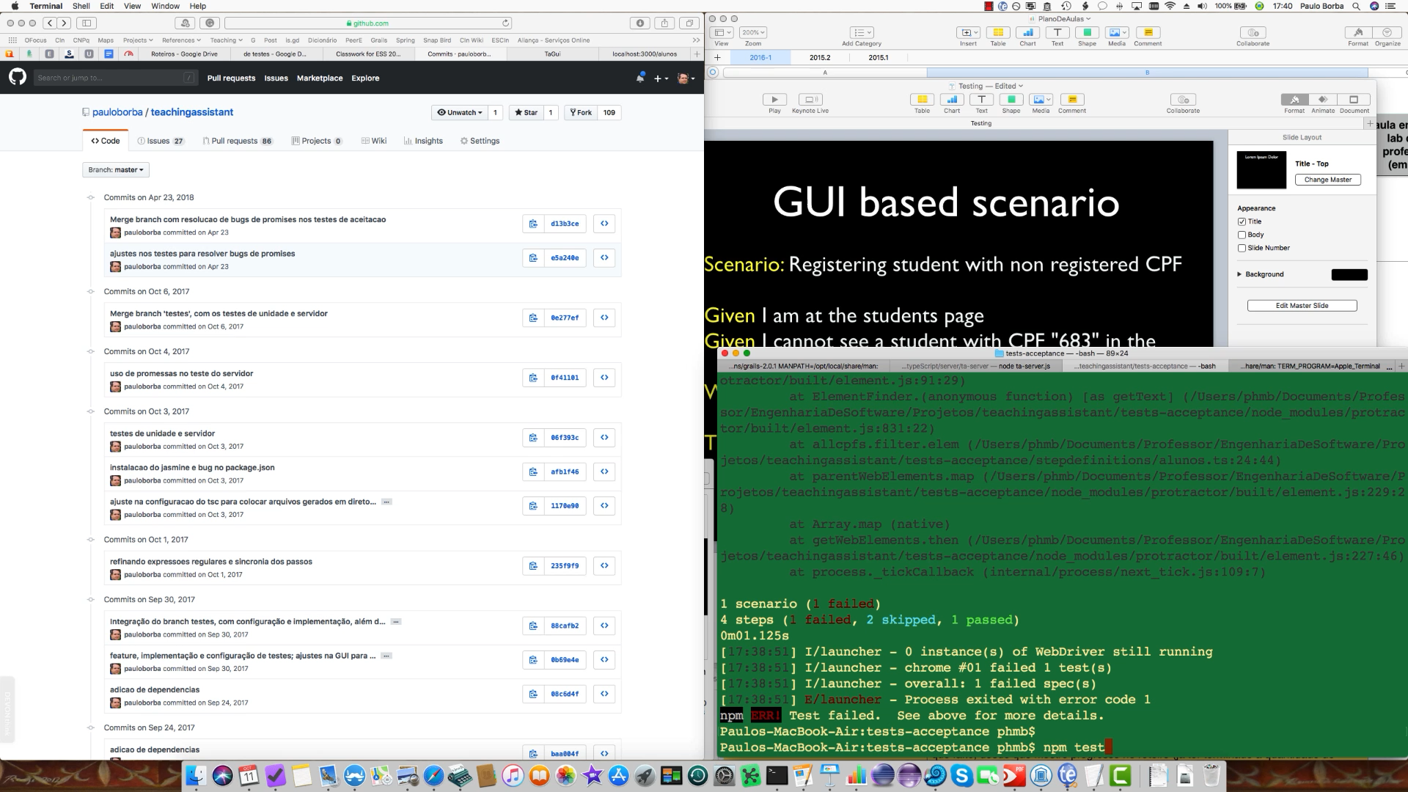
Executing tests

Slide 25
GUI based scenario
Scenario: Registering student with non registered CPF
Given I am at the students page
Given I cannot see a student with CPF "683" in the
students list
When I try to register the student "Paulo" with
CPF "683"
Then I can see "Paulo" with CPF "683" in the
students list

Slide 26
GUI based test step
Given(/^I am at the students page$/, async () => {
await browser.get(“http://localhost:4200/");
await expect(browser.getTitle()).to
.eventually.equal('TaGui');
await $(“a[name='alunos']").click();
})

Slide 27
Steps exercise the system under test (SUT) by simulating user actions in the browser

Slide 28
Software Engineering
Paulo Borba
Informatics Center
Federal University of Pernambuco
pauloborba.cin.ufpe.br

Slide 29
How to implement GUI acceptance tests?

Slide 30
For each commit…
Check commit changes
Starting at commit “adicao de nomes nos elementos HTML a serem referenciados pelos testes”, going up to “criacao da feature e testes de alunos”
Notes:
vai ate Integração do branch testes (basicamente so olhar ele)
AJUSTAR COMMITS POIS ESTAO BEM BAGUNCADOS
diffs ficam difíceis de visualizar na tela: unificar a visão ou mostrar o arquivo

Slide 31
Hands on exercises
Notes:
Indo de aluno por aluno, verificando o progresso, e registrando como comentário no assignment do classroom.
You can find assertions on the web that say
POST should be used to create a resource, and PUT should be used to modify one
PUT should be used to create a resource, and POST should be used to modify one
Neither is quite right.
Better is to choose between PUT and POST based on idempotence of the action.
PUT implies putting a resource - completely replacing whatever is available at the given URL with a different thing. By definition, a PUT is idempotent. Do it as many times as you like, and the result is the same. x=5 is idempotent. You can PUT a resource whether it previously exists, or not (eg, to Create, or to Update)!
POST updates a resource, adds a subsidiary resource, or causes a change. A POST is not idempotent, in the way that x++ is not idempotent.
By this argument, PUT is for creating when you know the URL of the thing you will create. POST can be used to create when you know the URL of the "factory" or manager for the category of things you want to create.
so:
POST /expense-report
or:
PUT /expense-report/10929

Slide 32
Testing 1: implementation, maintenance and execution
Notes:
DEIXAR PARTE DE SERVICO PARA A PROXIMA AULA: UM TIPO DE TESTE POR CADA AULA, FICA MELHOR DISTRIBUIDO, E EVITA AULAS SO DE ROTEIRO!!!!!!!!!

Slide 33
Testing 2: implementation, maintenance and execution

Slide 34
Software Engineering
Paulo Borba
Informatics Center
Federal University of Pernambuco
pauloborba.cin.ufpe.br

Slide 35
What are service acceptance tests?
Notes:
consiste basicamente em

Slide 36
Exercising the system through its server
Notes:
uma opção é testar exercitando a GUI …

Slide 37
Notes:
mas agora vamos discutir como testar exercitando o servidor…

Slide 38
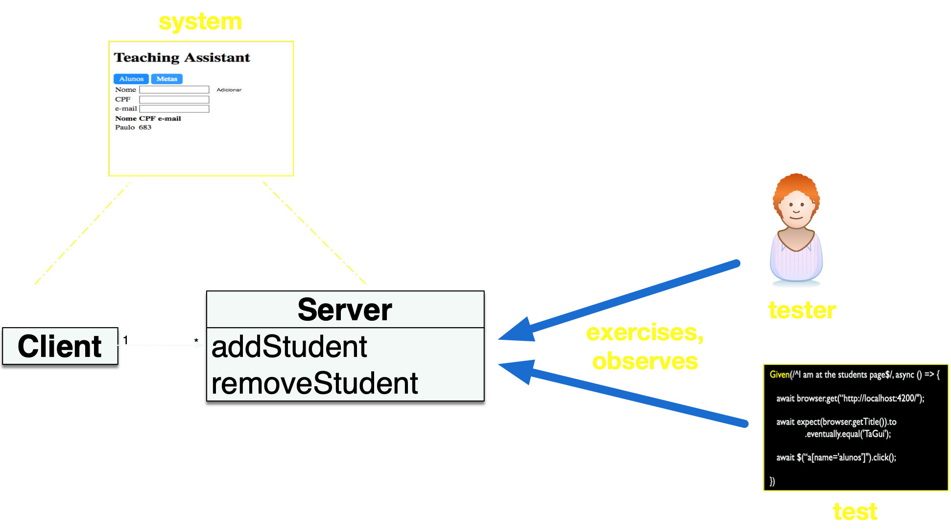
Notes:
mas por que os dois tipos de teste?

Slide 39
Why both GUI and service acceptance tests?
Notes:
primeiro…

Slide 40
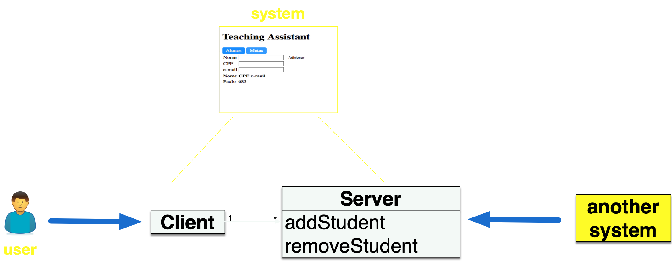
Make sure that system is OK for both users and other systems
Notes:
mas, cuidado

Slide 41
Not always needed, so consider your context
Notes:
o segundo principal motivo para ter os dois tipos de teste…

Slide 42
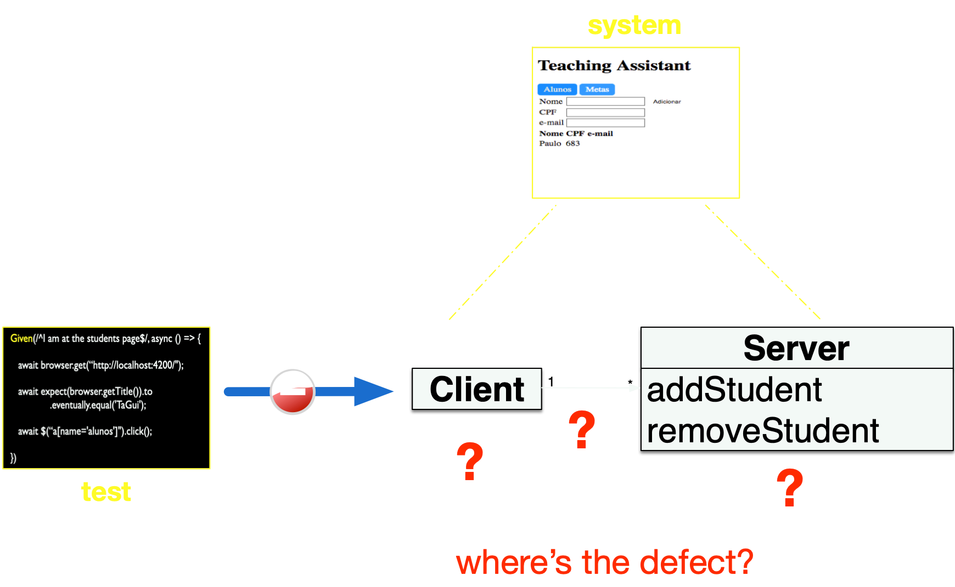
Help locating defects
Notes:
se os dois dao bronca…

Slide 43
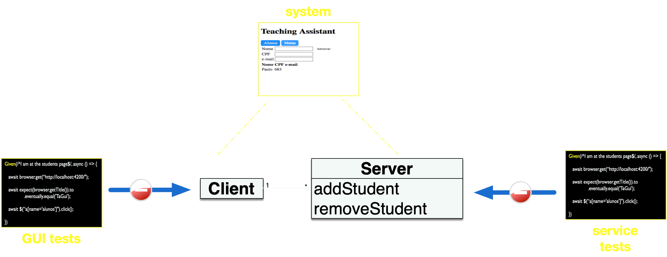
Problem likely in the server
Notes:
se so os de gui dao bronca

Slide 44
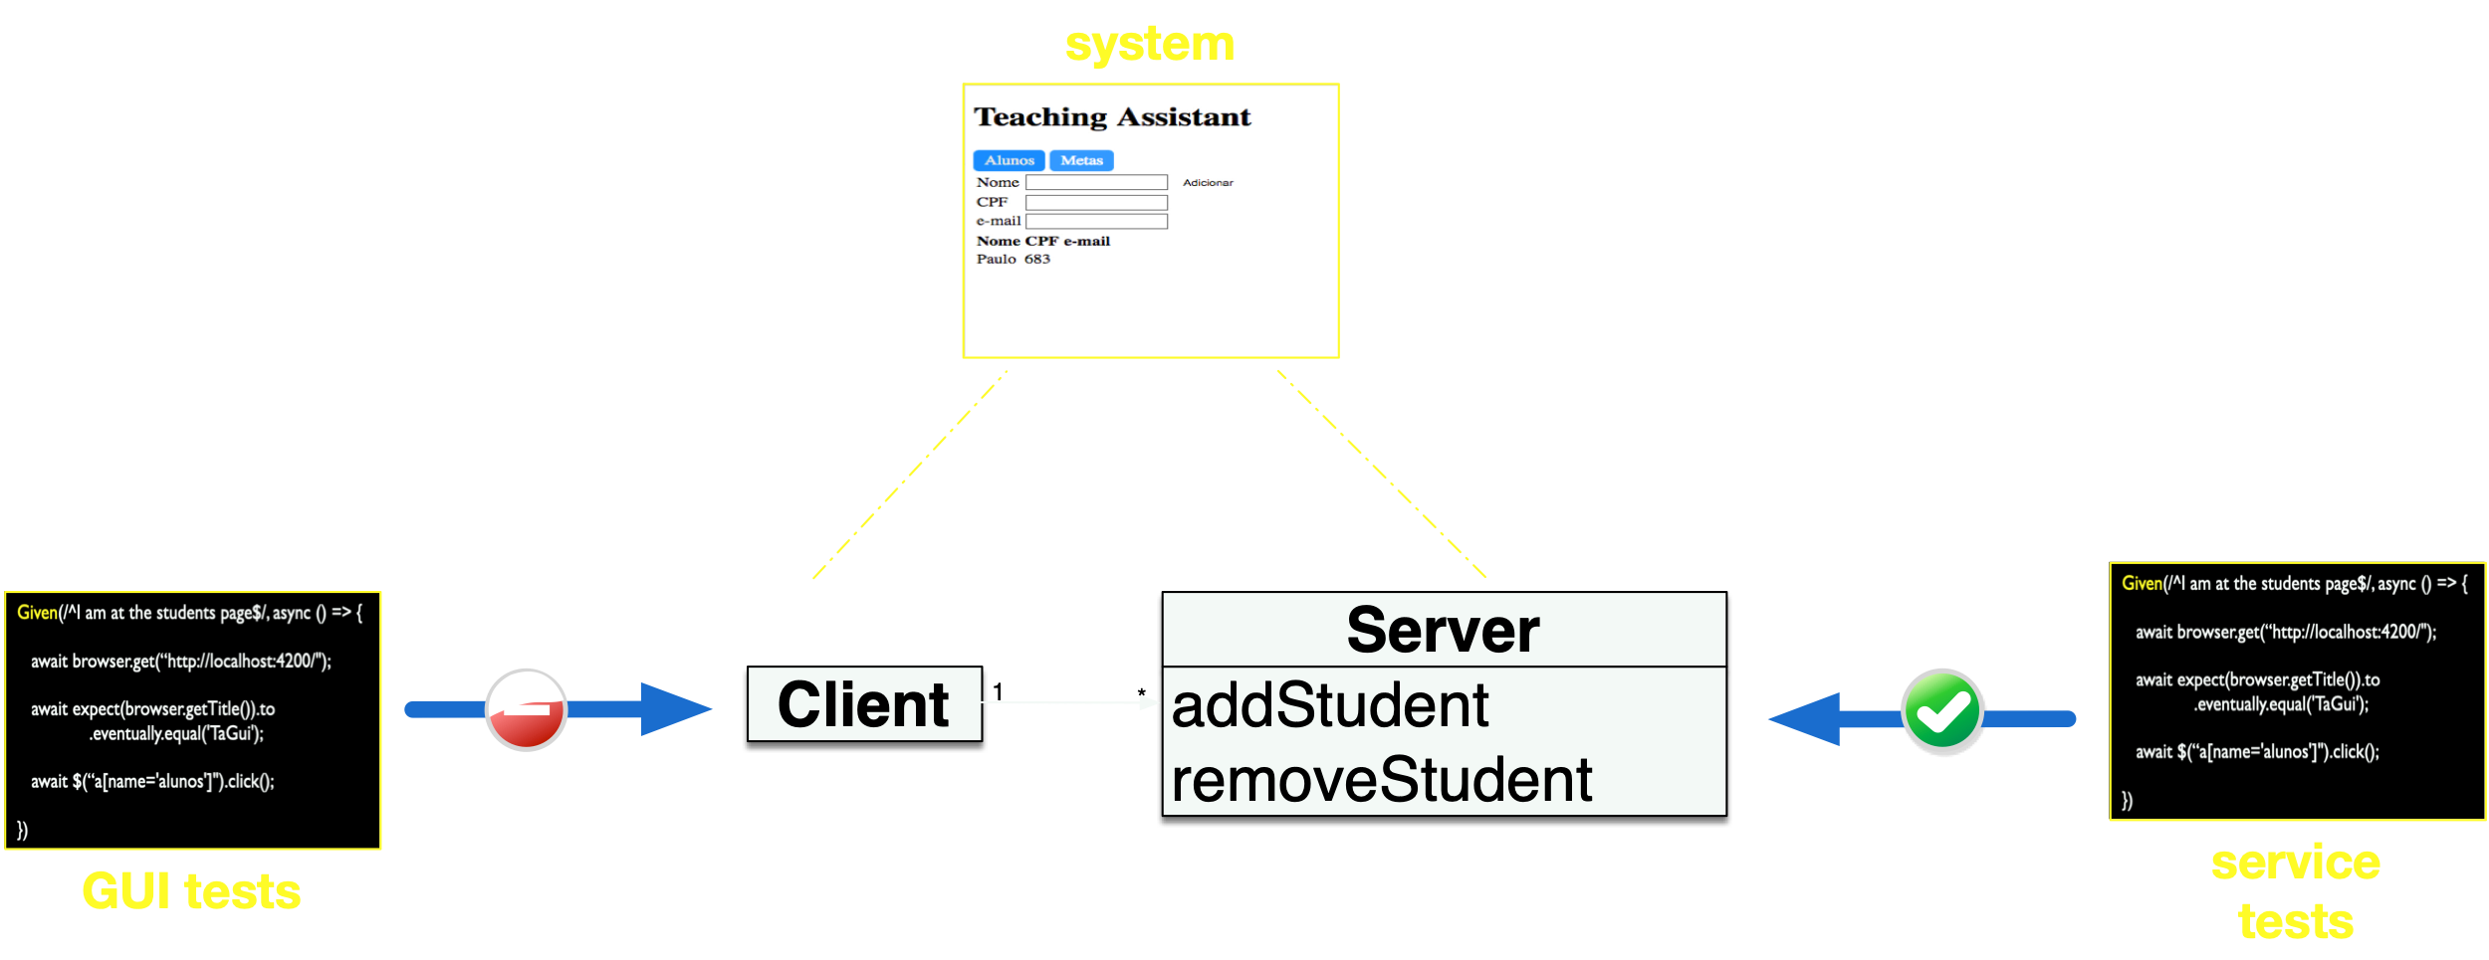
Problem likely in the client
Notes:
vamos ver agora um exemplo…

Slide 45
Service based scenario
Scenario: Registering student with non registered CPF,
service
Given the system has no student with CPF "683"
When I register the student "Paulo" with CPF "683"
Then the system now stores "Paulo" with CPF "683"
Notes:
nenhuma menção a gui na descrição e na implementação…

Slide 46
Service based test step
Given(/^the system has no student with CPF "(\d*)"$/,
async (cpf) => {
await request.get(base_url + "alunos")
.then(body =>
expect(body.includes(`"cpf":"${cpf}"`))
.to.equal(false));
});
})
Notes:
assumindo que o sistema é inicializado para cada teste
import request = require(“request-promise");
mesma implementação do teste do jasmine, fazer a mesma com o cucumber, e deixar claro que a redundância deve ser evitada. por isso, melhor usar outro exemplo la no jasmine. testar algo que ja não tenha sido testado na aceitação do servidor.

Slide 47
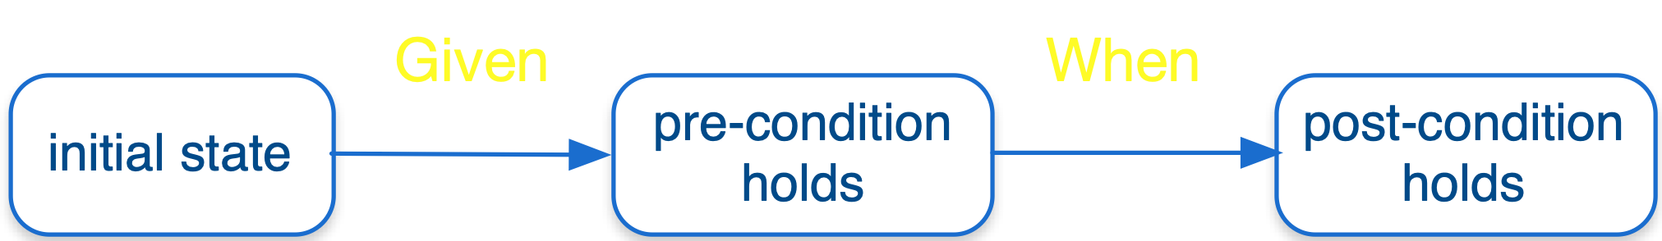
Given can possibly establish the pre-condition
Notes:
se pre-condition nao é valida no estado inicial

Slide 48
Steps exercise the system under test (SUT) by invoking services

Slide 49
Software Engineering
Paulo Borba
Informatics Center
Federal University of Pernambuco
pauloborba.cin.ufpe.br

Slide 50
How to implement service acceptance tests?

Slide 51
For each commit…
Check commit changes
Starting at commit “testes de aceitacao do servidor”, going up to “corrigindo teste de aceitacao de servico: usar parametro ao inves de …”
Notes:
verificar sincronia com o roteiro. AJUSTAR COMMITS POIS ESTAO BEM BAGUNCADOS
vi as mudanças no servidor, cadastro de alunos, e aluno service, explicando um pouco de promise (precisa de slides e explicações bem melhores)
faltou ver as mudanças nos componentes que chamam o aluno service

Slide 52
Software Engineering
Paulo Borba
Informatics Center
Federal University of Pernambuco
pauloborba.cin.ufpe.br

Slide 53
How to review cucumber tests?

Slide 54
Checklist

Slide 55
Test behavior should strictly conform to scenario semantics
Given(/^I am at the students page$/, async () => {
await browser.get(“http://localhost:4200/");
await expect(browser.getTitle()).to
.eventually.equal('TaGui');
await $(“a[name='alunos']").click();
await expect(browser.getTitle()).to
.eventually.equal(‘Students');
})

Slide 56
Avoid ambiguities due to similar step sentences
Given I cannot see a student with CPF "683"
in the students list
/^I cannot see a student with CPF "(\d*)"
in the students list$/
a scenario description step should match only one expression in the step implementations
Notes:
assumindo que tinha um outro step I cannot see a student with CPF "683" para verificar presença na tabela de metas

Slide 57
Do not duplicate test code
def fillLoginDataOnly(...) {
$("form").username = username
$("form").password = password
}
def fillLoginDataAndSubmit(...) {
fillLoginDataOnly(...)
$("form").click()
}
def fillLoginDataAndSubmit(...) {
$("form").username = username
$("form").password = password
$("form").click()
}

Slide 58
Tests should clean up environment at the end
...
def uploadsFolder = new File(...)
uploadsFolder.listFiles().each {
innerFile =>
innerFile.deleteOnExit()
}

Slide 59
Tests should be platform (including browser) and language independent
await $("input[name='cpfbox']").sendKeys(<string> cpf);
await element(by.buttonText('Adicionar')).click();
await $("input[name='cpfbox']").sendKeys(<string> cpf);
await element(by.buttonText(
prop.getButtonAddStudent()
)).click();
Notes:
cuidado pq pode passar localmente e não no travis por conta disso! idioma, formato de datas e moeda, versão do browser, e html5

Slide 60
Hands on exercises
Notes:
Indo de aluno por aluno, verificando o progresso, e registrando como comentário no assignment do classroom.
You can find assertions on the web that say
POST should be used to create a resource, and PUT should be used to modify one
PUT should be used to create a resource, and POST should be used to modify one
Neither is quite right.
Better is to choose between PUT and POST based on idempotence of the action.
PUT implies putting a resource - completely replacing whatever is available at the given URL with a different thing. By definition, a PUT is idempotent. Do it as many times as you like, and the result is the same. x=5 is idempotent. You can PUT a resource whether it previously exists, or not (eg, to Create, or to Update)!
POST updates a resource, adds a subsidiary resource, or causes a change. A POST is not idempotent, in the way that x++ is not idempotent.
By this argument, PUT is for creating when you know the URL of the thing you will create. POST can be used to create when you know the URL of the "factory" or manager for the category of things you want to create.
so:
POST /expense-report
or:
PUT /expense-report/10929

Slide 61
Testing 2: implementation, maintenance and execution

Slide 62
Testing 3: implementation, maintenance and execution
Notes:
talvez primeira parte dessa aula deva ser para finalizar 15 e 16 do roteiro. o roteiro esta desbalanceado. muito exercício para testes de aceitação

Slide 63
Software Engineering
Paulo Borba
Informatics Center
Federal University of Pernambuco
pauloborba.cin.ufpe.br
Notes:
já vimos de forma concreta alguns tipos de teste, mas é importante ter uma visão mais ampla…

Slide 64
Which are the basic types of test?
Notes:
didicil responder essa pergunta pois…

Slide 65
Many test classifications!
Some are orthogonal…
Not much consistency in the literature
Notes:
mas vamos considerar algumas dimensões que servem para caracterizar testes…

Slide 66
Quality factor to be verified by the test
Correctness (functional)
Performance
Security
Usability (A/B)
Robustness
Compatibility
…
Notes:
outra dimensão, caracteristica, é…

Slide 67
Programming entity directly exercised by the test
GUI
Class
Method
Service
…
Notes:
parte da ideia vem daqui http://www.codingthearchitecture.com/2015/06/12/unit_and_integration_are_ambiguous_names_for_tests.html, mas na verdade adaptei um pouco as ideias, e divirjo em alguns pontos

Slide 68
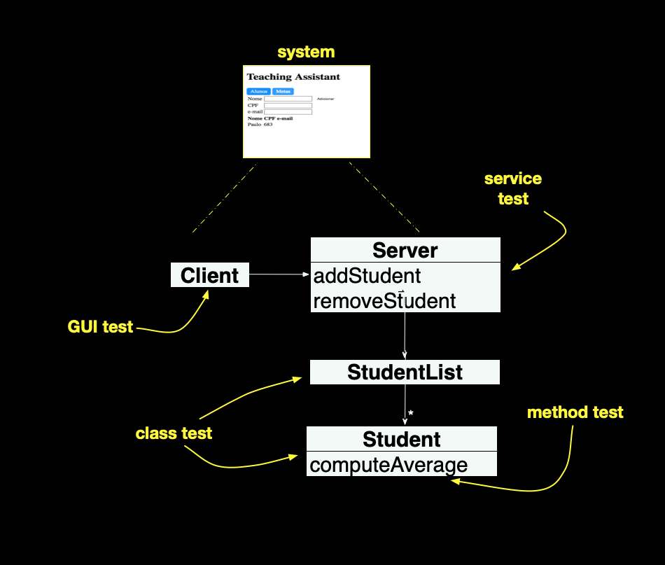
Notes:
agora, para classificar um teste especifico, usamos valores de dimensoes especificas
por exemplo, um teste funcional de GUI, um teste de usabilidade de GUI, um teste funcional de serviço, um teste de performance de serviço, um teste de performance de GUI,etc
uma outra dimensão importante na caracterização de um teste…

Slide 69
Dependencies used to run the test
Unit: old version of dependencies, or even stubs and drivers
Integration: new version of dependencies evolved by other developers
End-to-end: as in integration, but all dependencies involved
System: as in end-to-end, but external dependencies from the production environment

Slide 70
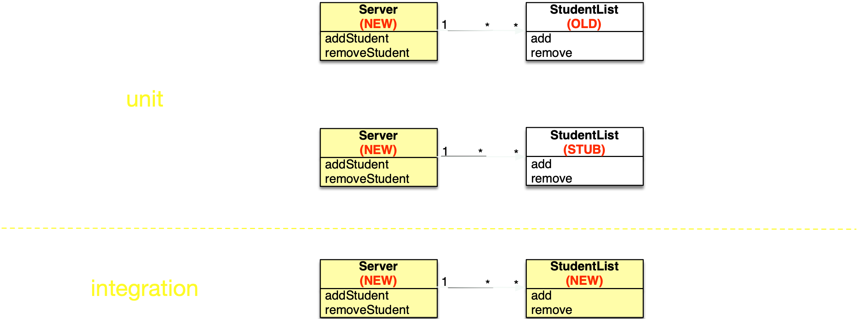
Assuming a class and its dependence are independently evolving…
Notes:
e precisamos dos dois…

Slide 71
Unit test gives no guarantee that system works after code integration
Integration test gives such guarantee, but doesn’t help to locate error or to give weaker guarantees early on

Slide 72
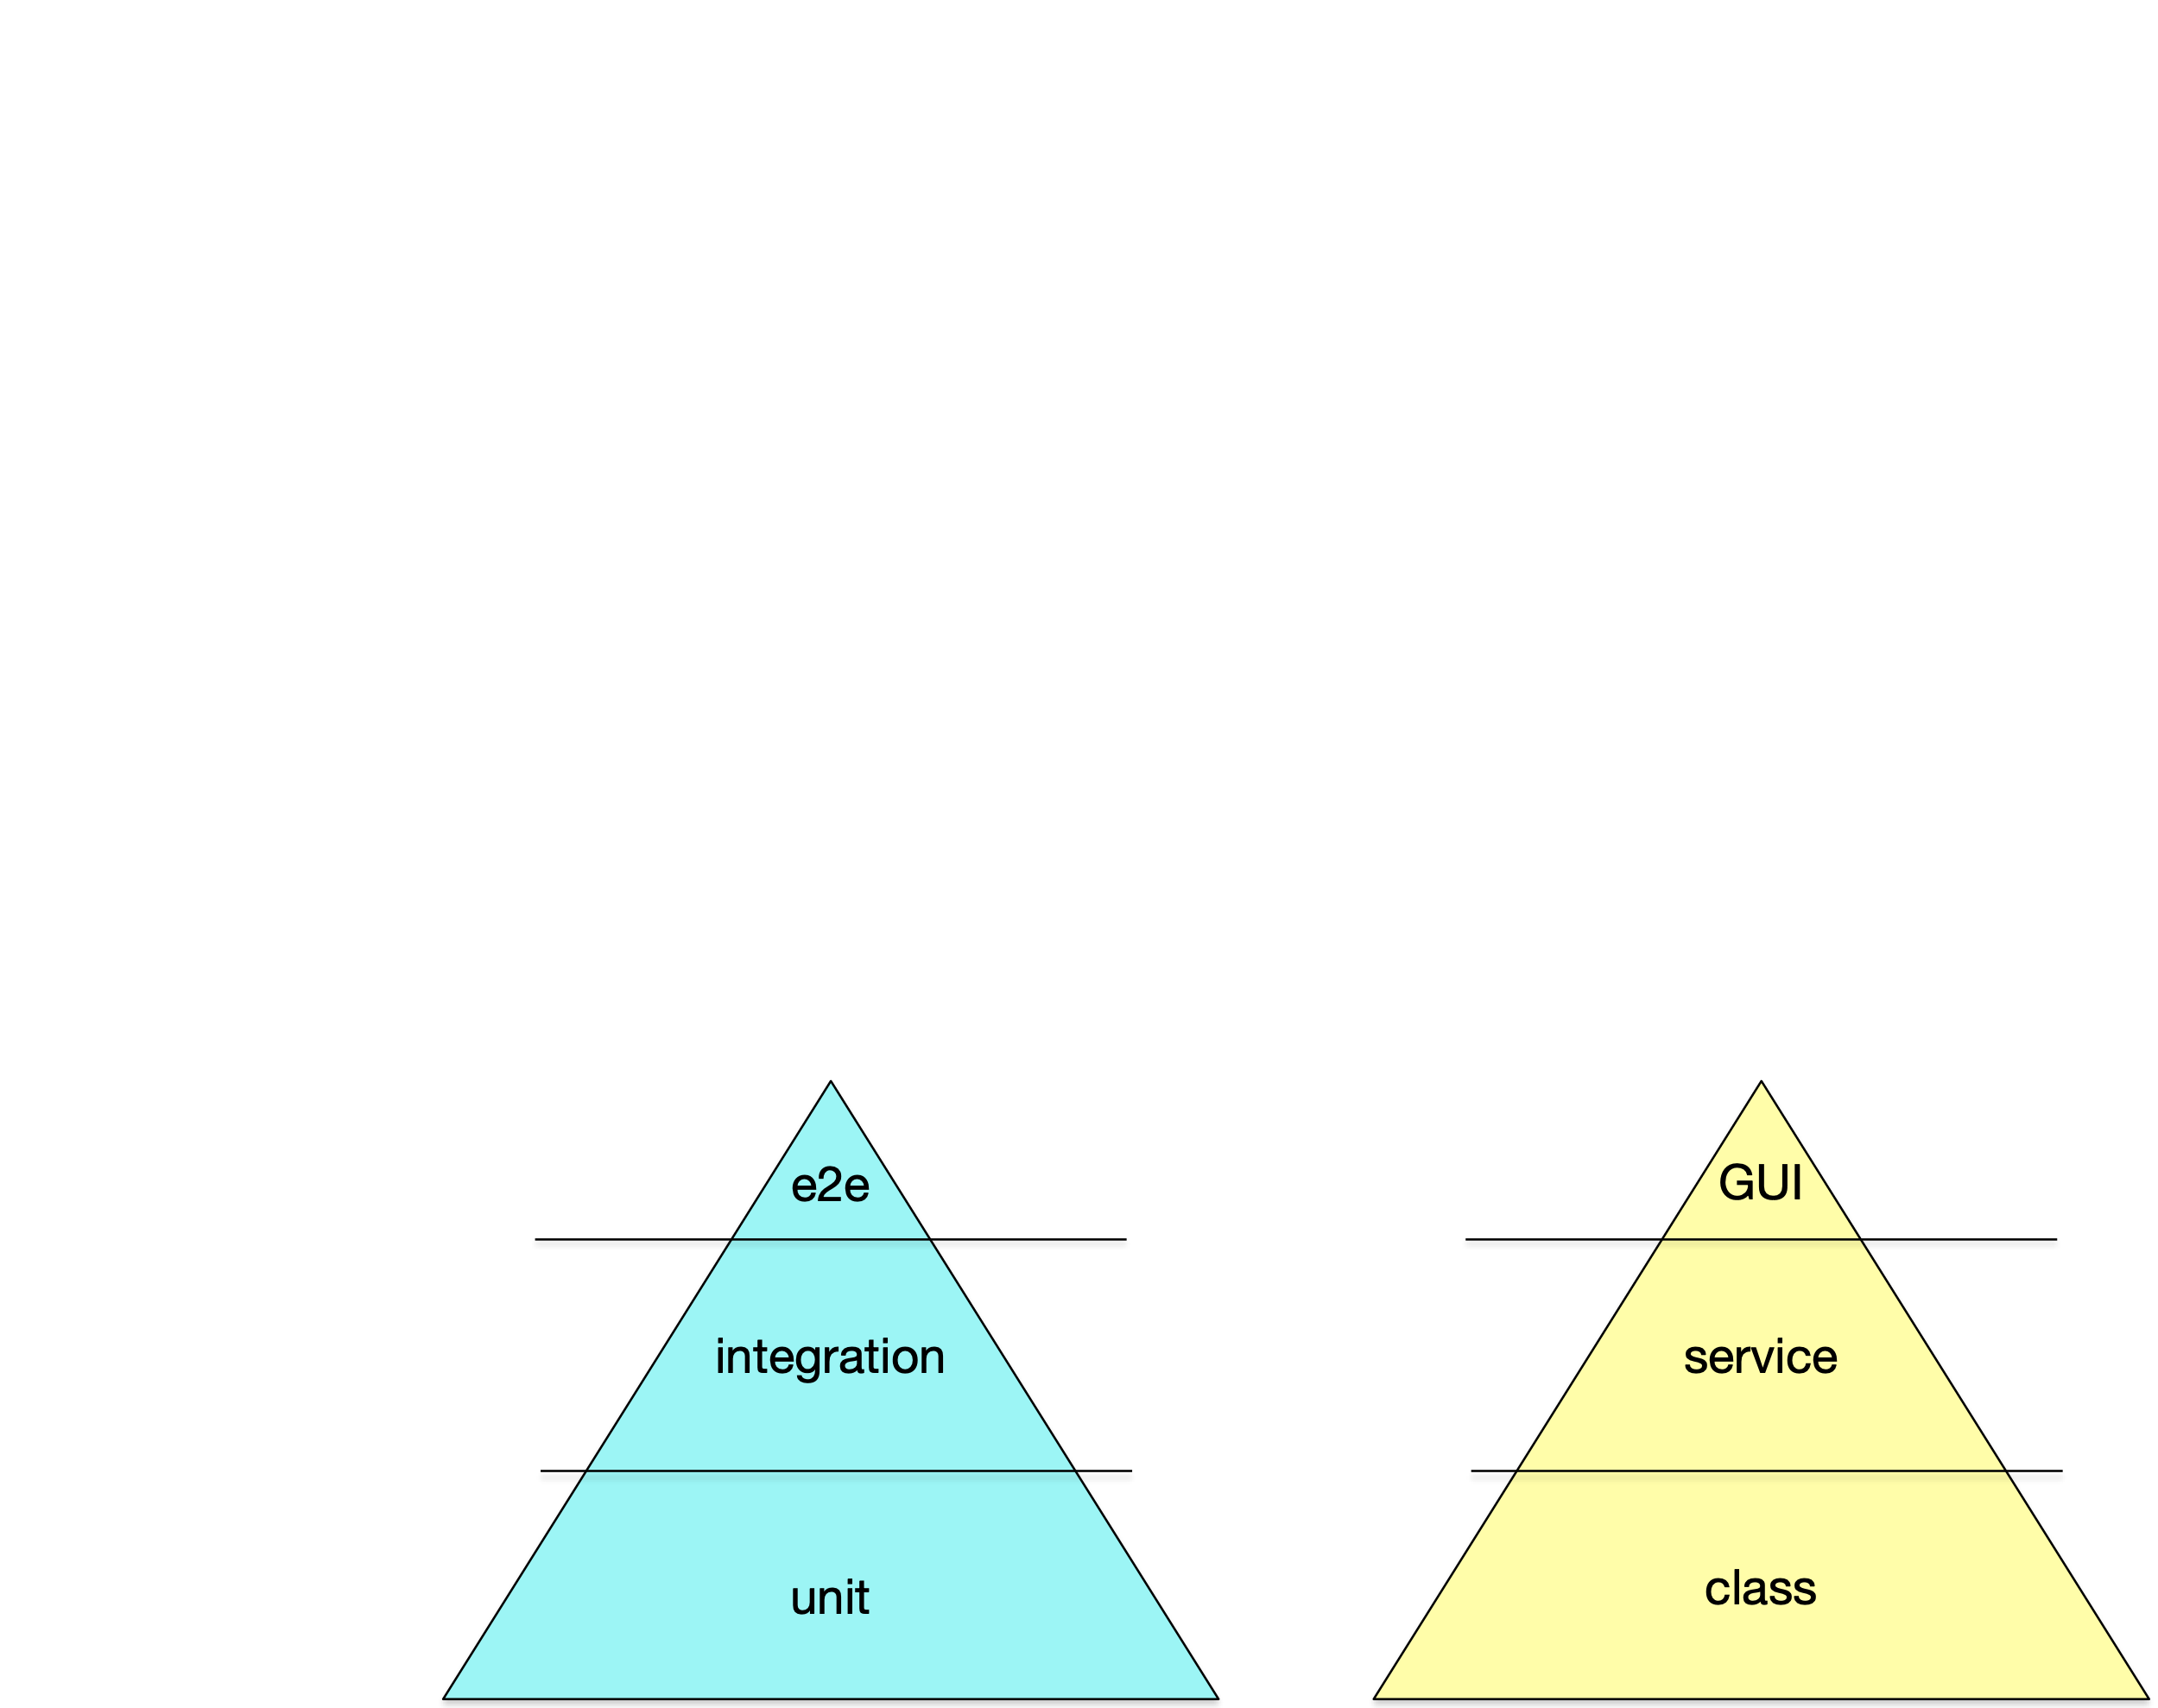
Test pyramids
Notes:
http://googletesting.blogspot.co.uk/2015/04/just-say-no-to-more-end-to-end-tests.html?m=1
Even with both unit tests and integration tests, you probably still will want a small number of end-to-end tests to verify the system as a whole. To find the right balance between all three test types, the best visual aid to use is the testing pyramid.

Slide 73
One can also have test suites with different shapes, for different situations: before a commit, after merging, before a release, etc.

Slide 74
Guarantee provided by the test
Acceptance: the tests justify product acceptance, play the role of a contract
Regression: the tests give evidence that previously tested behavior was not affected
Smoke: the tests give evidence that basic system behavior is OK
Notes:
regression focuses on evolution in time
differential focuses on evolution in space

Slide 75
Software Engineering
Paulo Borba
Informatics Center
Federal University of Pernambuco
pauloborba.cin.ufpe.br

Slide 76
What are (non acceptance) service tests?

Slide 77
Non acceptance service tests
directly exercises services
not directly derived from explicit requirements
regression or smoke, depending on complexity and in which suite it is included
functional
unit, integration, or system, depending on selected dependencies

Slide 78
Service test, no link with scenarios
describe("O servidor", () => {
it("inicialmente retorna uma lista de alunos vazia", () => {
return request.get(base_url + "alunos").then(body =>
expect(body).toBe("[]")).catch(e =>
expect(e).toEqual(null));
})
test action
expected result
Notes:
ajustar commits pois commits iniciais não usam promise no código acima!

Slide 79
Might check implicit requirements
it("só cadastra alunos", () => {
var options = {method: 'POST', uri: (base_url + "aluno"),
body: {name: "Mari", cpf: "962"},
json: true};
return request(options)
.then(body =>
expect(body).toEqual({failure: "O aluno não
pode ser cadastrado”}))
.catch(e => expect(e).toEqual(null))
});

Slide 80
Common actions and state for tests in a suite
var server:any;
beforeAll(() => {
server = require(‘../ta-server')
});
afterAll(() => {
server.closeServer()
});
test suite
setup
test suite
cleanup

Slide 81
Code exercises the system under test (SUT) by invoking services

Slide 82
Not driven by scenarios, but by properties developers want to check (component interfaces/contracts, assumptions, etc.)

Slide 83
Software Engineering
Paulo Borba
Informatics Center
Federal University of Pernambuco
pauloborba.cin.ufpe.br

Slide 84
How to implement non acceptance service tests?

Slide 85
For each commit…
Check commit changes
Starting at commit ajustes na configuracao para testes do servidor”, going up to “testes de servidor”
Notes:
NAO FIZ VIDEO. FARIA SENTIDO FAZER UM BEM CURTO, SO PARA EXPLICAR UM TESTE A MAIS E AS CONFIGURACOES. MELHOR FAZER QUANDO TIVER MAIS COISA. AJUSTAR COMMITS POIS ESTAO BEM BAGUNCADOS
vi as mudanças no servidor, cadastro de alunos, e aluno service, explicando um pouco de promise (precisa de slides e explicações bem melhores)
faltou ver as mudanças nos componentes que chamam o aluno service

Slide 86
Hands on exercises
Notes:
Indo de aluno por aluno, verificando o progresso, e registrando como comentário no assignment do classroom.
You can find assertions on the web that say
POST should be used to create a resource, and PUT should be used to modify one
PUT should be used to create a resource, and POST should be used to modify one
Neither is quite right.
Better is to choose between PUT and POST based on idempotence of the action.
PUT implies putting a resource - completely replacing whatever is available at the given URL with a different thing. By definition, a PUT is idempotent. Do it as many times as you like, and the result is the same. x=5 is idempotent. You can PUT a resource whether it previously exists, or not (eg, to Create, or to Update)!
POST updates a resource, adds a subsidiary resource, or causes a change. A POST is not idempotent, in the way that x++ is not idempotent.
By this argument, PUT is for creating when you know the URL of the thing you will create. POST can be used to create when you know the URL of the "factory" or manager for the category of things you want to create.
so:
POST /expense-report
or:
PUT /expense-report/10929

Slide 87
Testing 3: implementation, maintenance and execution
Notes:
talvez primeira parte dessa aula deva ser para finalizar 15 e 16 do roteiro. o roteiro esta desbalanceado. muito exercício para testes de aceitação

Slide 88

then
catch
“TA GUI"

Slide 89
Testing 4: implementation, maintenance and execution
Notes:
talvez primeira parte dessa aula deva ser para finalizar 15 e 16 do roteiro. o roteiro esta desbalanceado. muito exercício para testes de aceitação

Slide 90
Software Engineering
Paulo Borba
Informatics Center
Federal University of Pernambuco
pauloborba.cin.ufpe.br

Slide 91
How to implement class tests?
(unit, integration)

Slide 92
Class test, no link with scenarios
describe("O cadastro de alunos", () => {
var cadastro: CadastroDeAlunos;
beforeEach(() => cadastro = new CadastroDeAlunos())
it("é inicialmente vazio", () => {
expect(cadastro.getAlunos().length).toBe(0);
})
test setup
simple test, no action

Slide 93
it("doesn't accept students with the same CPF ", () => {
var student: Student = new Student();
student.name = "Mariana";
student.cpf = "683";
cadastro.add(student);
student = new Student();
student.name = "Pedro";
student.cpf = "683";
cadastro.add(student);
expect(cadastro.getStudents().length).toBe(1);
})
object creation and initialisation, test setup,
input
method calls,
test actions
expected result assertions

Slide 94
Code exercises the system under test (SUT) by creating objects and invoking methods

Slide 95
Not driven by scenarios, but by properties developers want to check (method specifications, invariants, etc.)

Slide 96
Software Engineering
Paulo Borba
Informatics Center
Federal University of Pernambuco
pauloborba.cin.ufpe.br

Slide 97
How to design tests?
Notes:
para entender a resposta dessa pergunta, primeiro temos que fazer uma distinção importante…

Slide 98
Write tests right
versus
Write the right tests
Notes:
como então saber quais os testes certos, que merecem ser implementados e executados?

Slide 99
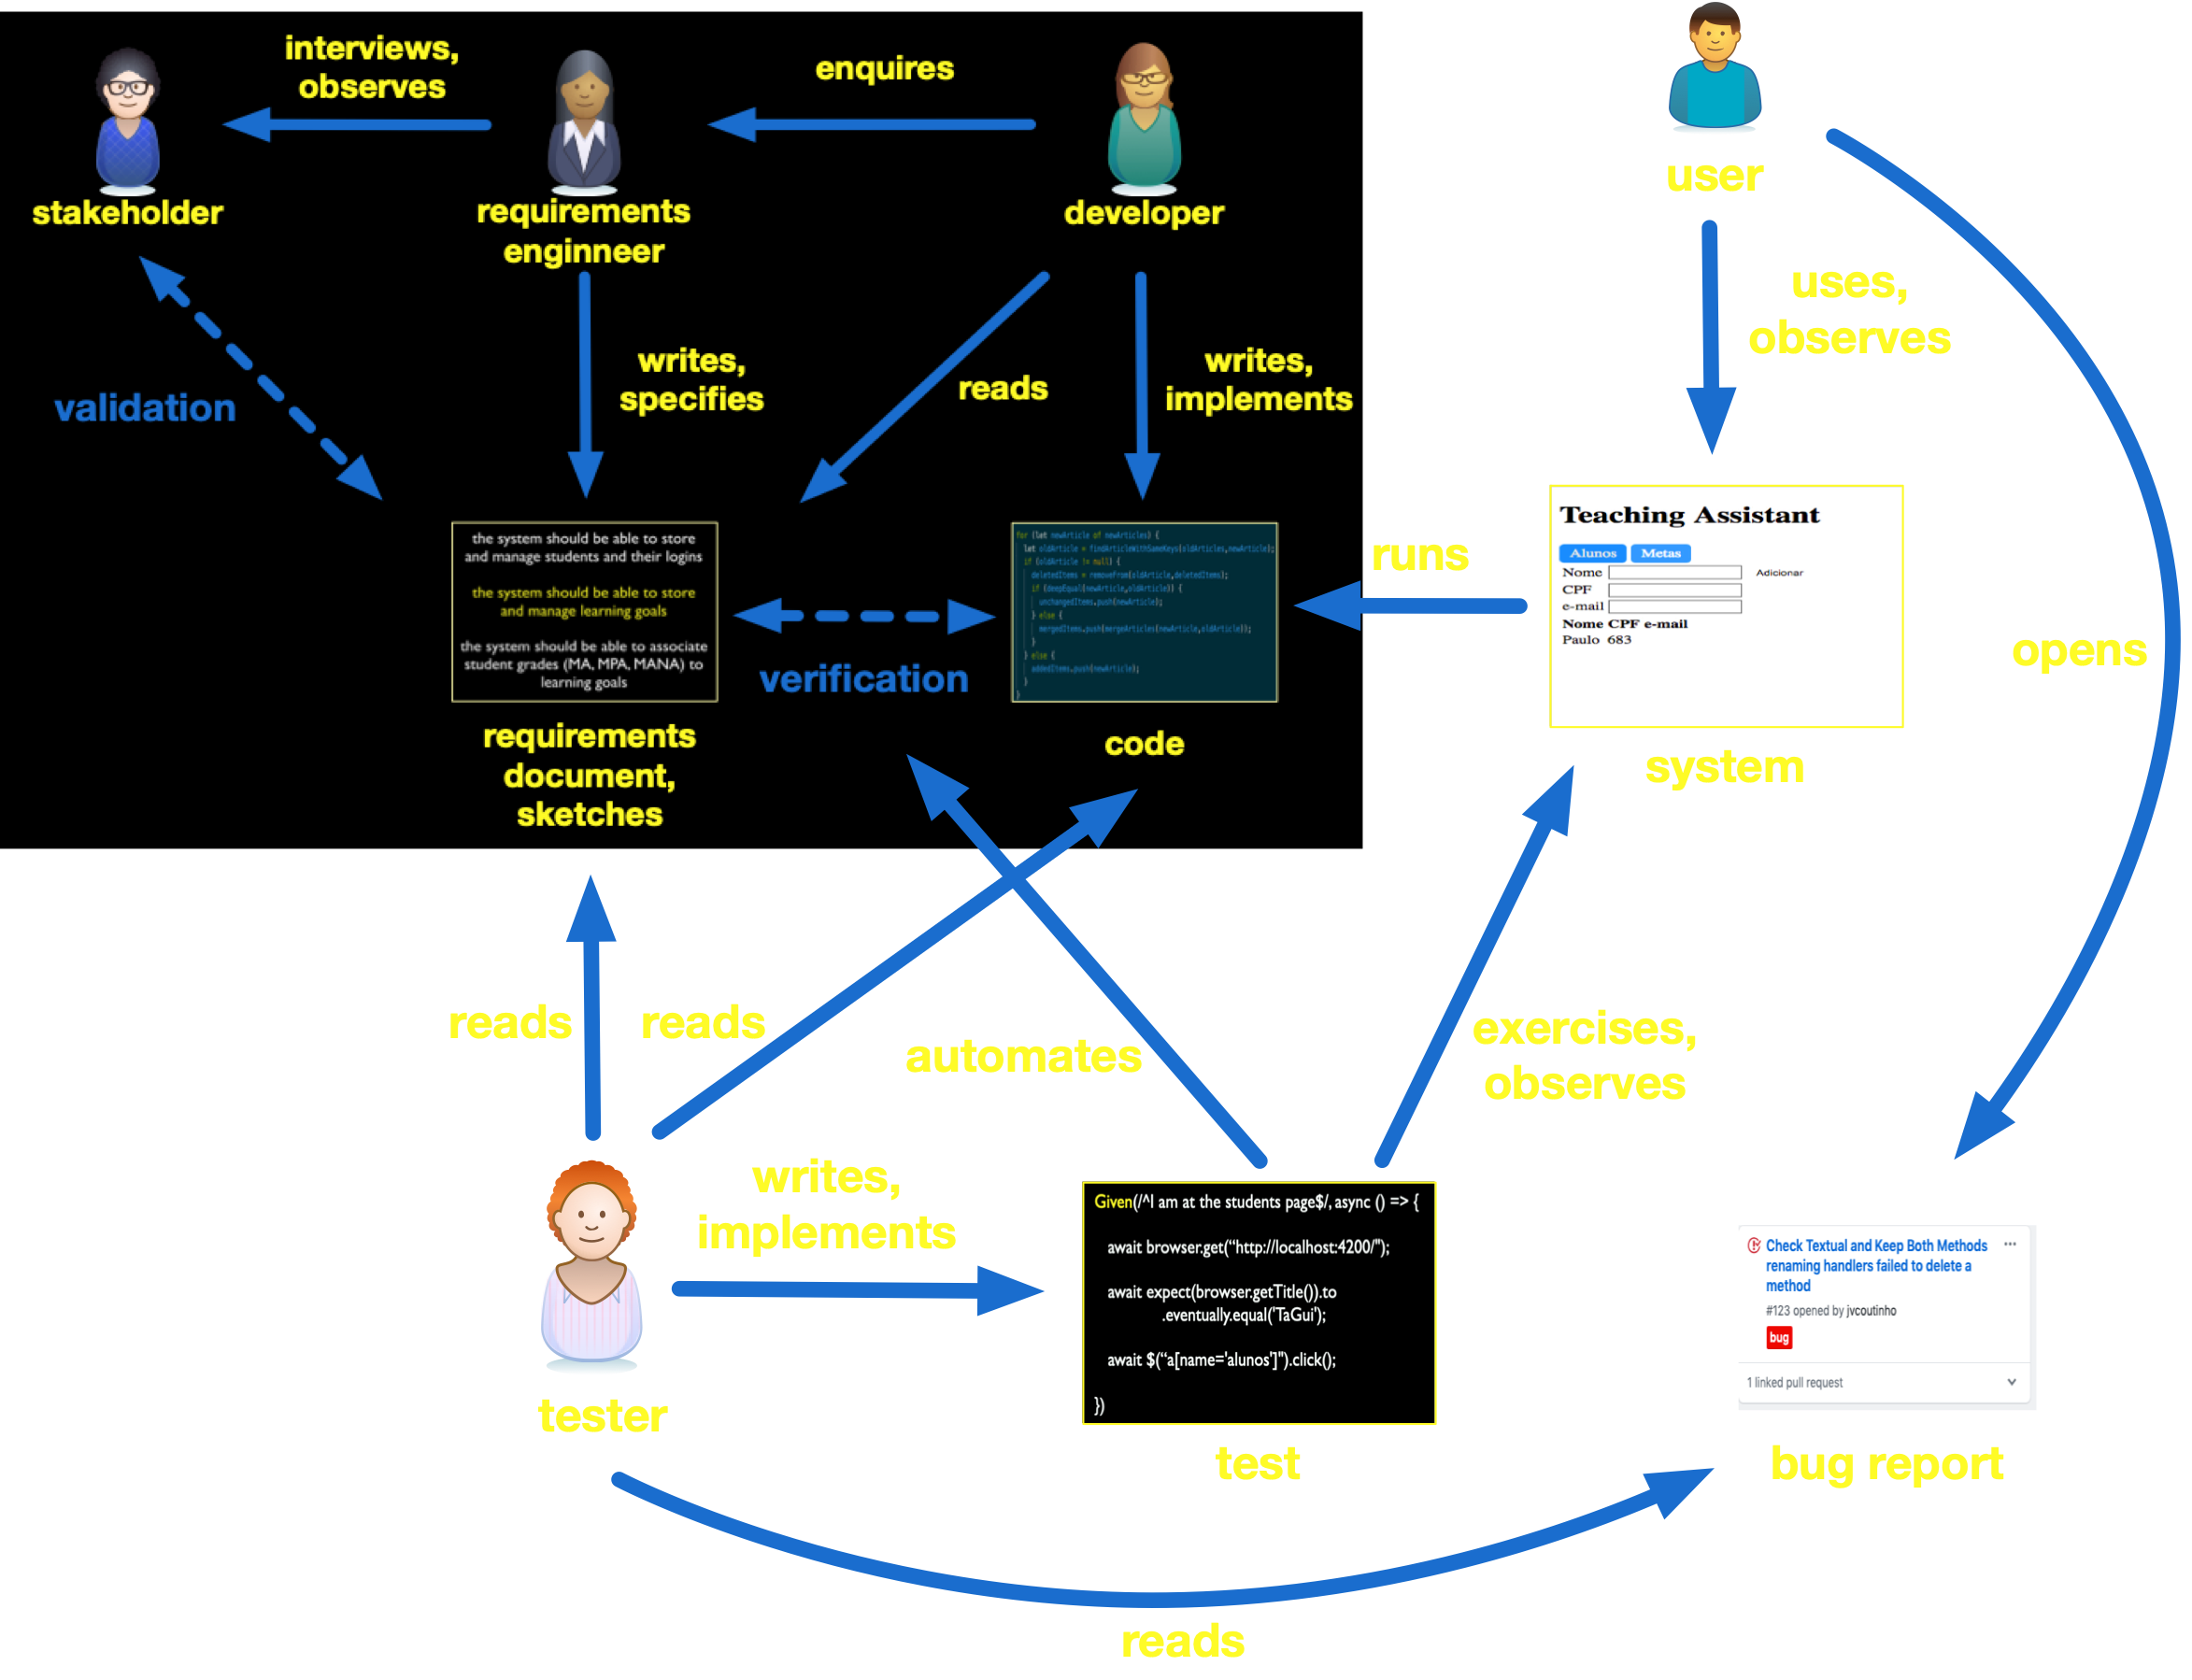
Notes:
mas mesmo assim temos que saber focar no mais importante, priorizar entre os requisitos e os bugs reports, o que mais precisa ser testado…

Slide 100
You won’t have time to fully test the implemented functionality
So invest your time on tests that are relevant, exercise more critical behavior and states

Slide 101
Focus on exercising more relevant (for both the stakeholders and the project) and complex behavior and states
requirements, rules,
constraints, event sequences,
cases, etc.
not working properly will lead to significant problems (loss, complaints, etc.)
not sure if it was completely understood or was implemented right

Slide 102
More principles

Slide 103
Weakening the pre condition

Slide 104
The more input states are exercised by your test suite, the stronger guarantees are provided by the suite

Slide 105
Exercise the same operations and functionality with different inputs (arguments and state content)
focus on representative inputs
boundary cases
empty - full - some elements
positive - negative - 0
one MANA - no MANA - no MA
aim is to increase coverage, avoiding redundancy

Slide 106
Input space is often multi-dimensional
Hardware platforms (devices)
Operating system, browser, library and auxiliary system versions, environment variables
Product configurations and options, for configurable systems and product lines
Processes, queues (notifications), network latency
Notes:
https://tidbits.com/2019/10/21/six-reasons-why-ios-13-and-catalina-are-so-buggy
necessidade de testar em varios contextos

Slide 107
Strengthening the post condition

Slide 108
The more constraints in the expected results of a test, the stronger guarantees are provided by the test

Slide 109
Checking if a report was generated…
file report.pdf exists and is non empty?
and is a valid PDF file?
and does not contain page numbers?
and contains a section on student evaluation?
and this section contents is compatible with the data currently stored by the system?
positive verification
negative verification

Slide 110
Right balance between the different kinds of tests
GUI, service, and class tests
Unit, integration, and end-to-end tests
and their combinations

Slide 111
Each test should run independently of the others
assuming a fresh system instance
without assuming or leaving side-effects
with the aim of reusability and compositionality
if deletion test depend on the insertion test, we won’t be able to execute the first alone

Slide 112
We should try to have the same for test steps, but one step might have to setup state for another step

Slide 113
Regression testing
Before pushing (sometimes committing), make sure all tests pass

Slide 114
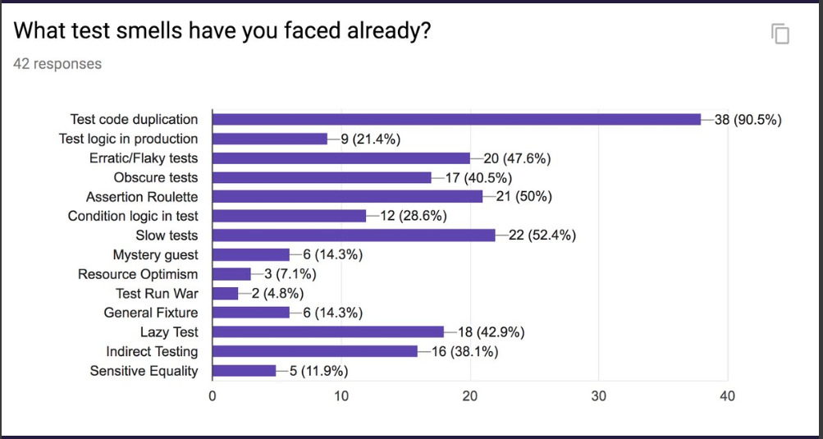
http://www.mauricioaniche.com
http://xunitpatterns.com

Slide 115
Practices

Slide 116
Tests
as partial
specifications

Slide 117
Behavior driven design
acceptance (GUI or service) test implementation before feature implementation

Slide 118
Test driven design
class test implementation before class or method implementation

Slide 119
Test driven development (TDD)
TDD = test-first development + (small cycles of red-green-refactoring)
test-first likely lead to more tests, tests of better quality, having a positive effect on software quality (but existing evidence is questionable)
it might also help to better think about the problem before actually implementing it; test playing the role of specification
small cycles of red-green-refactoring lead to better defined small tasks, and stable progress, with possible positive impact on productivity
Notes:
What Do We (Really)
Know about Test-Driven
Development?

Slide 120
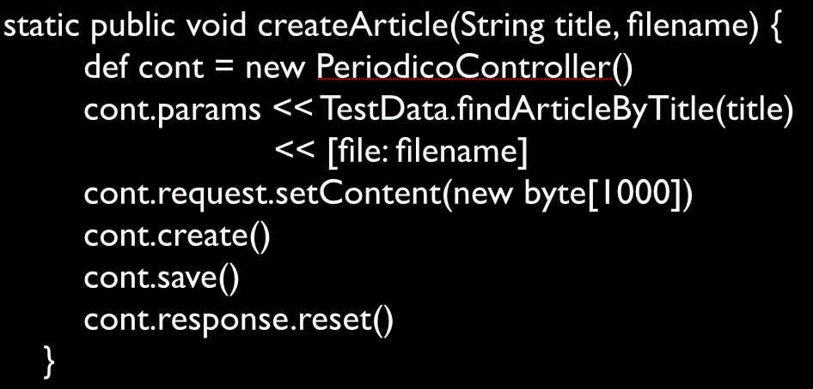

Create interface when little functionality is available
functionality interface
class PeriodicoController {
create() {}
save() {}
}

Slide 121
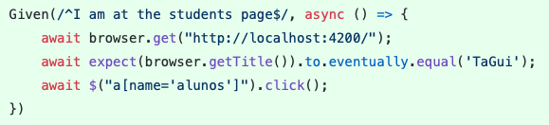
Interface is not always a list of method signatures
HTML interface
<a name="alunos">
</a>

Slide 122
Requires established architecture and code structure, but not the actual implementation

Slide 123
Debugging
use a proper tool
step back
find the wrong assumption
change code

Slide 124
Software Engineering
Paulo Borba
Informatics Center
Federal University of Pernambuco
pauloborba.cin.ufpe.br

Slide 125
How to implement class tests?
(unit, integration)

Slide 126
For each commit…
Check commit changes
Starting at commit “ajustes na configuracao para testes de unidade”, going up to “refinamento do teste de CPF duplicado, e refatoracao”
Notes:
NAO FIZ VIDEO PARA ESSA PARTE, JA BEM COBERTO NOS SLIDES. AJUSTAR COMMITS POIS ESTAO BEM BAGUNCADOS
vi as mudanças no servidor, cadastro de alunos, e aluno service, explicando um pouco de promise (precisa de slides e explicações bem melhores)
faltou ver as mudanças nos componentes que chamam o aluno service

Slide 127
Take notes, now!

Slide 128
Hands on exercises
Notes:
Indo de aluno por aluno, verificando o progresso, e registrando como comentário no assignment do classroom.
You can find assertions on the web that say
POST should be used to create a resource, and PUT should be used to modify one
PUT should be used to create a resource, and POST should be used to modify one
Neither is quite right.
Better is to choose between PUT and POST based on idempotence of the action.
PUT implies putting a resource - completely replacing whatever is available at the given URL with a different thing. By definition, a PUT is idempotent. Do it as many times as you like, and the result is the same. x=5 is idempotent. You can PUT a resource whether it previously exists, or not (eg, to Create, or to Update)!
POST updates a resource, adds a subsidiary resource, or causes a change. A POST is not idempotent, in the way that x++ is not idempotent.
By this argument, PUT is for creating when you know the URL of the thing you will create. POST can be used to create when you know the URL of the "factory" or manager for the category of things you want to create.
so:
POST /expense-report
or:
PUT /expense-report/10929

Slide 129
Testing 4: implementation, maintenance and execution
Notes:
talvez primeira parte dessa aula deva ser para finalizar 15 e 16 do roteiro. o roteiro esta desbalanceado. muito exercício para testes de aceitação

Slide 130
Testing research at CIn
Test generation and static analysis tools: Marcelo e Paulo
Model-based testing: Alexandre Mota, Juliano e Augusto
Test selection and execution: Juliano

Slide 131
To do after class
Answer questionnaire (check classroom assignment), study correct answers
Finish exercise (check classroom assignment), study correct answers
Read, again, chapter 7 and basic concepts of chapter 6 in the textbook
Evaluate classes (check classroom assignment)
Study questions from previous exams

Slide 132
Questions from previous exams
Explique brevemente a diferença entre testes de unidade e testes de integração (a). Qual o impacto negativo de realizar apenas os testes de unidade? (b) Qual o impacto negativo de realizar apenas os testes de integração?
Explique brevemente a diferença entre testes de aceitação e testes de integração, e porque você acha que algumas empresas realizam os dois tipos de teste.

Slide 133
Software development
Paulo Borba
Informatics Center
Federal University of Pernambuco
phmb@cin.ufpe.br ◈ twitter.com/pauloborba

